Slide 1
SEP2 Presentation
Made By Flemming Vindelev 251398
Ionel-Cristinel Putinica 266123
Mihail Rumenov Kanchev 266106

Slide 2
Table of Content
Scrum
Testing
Database
System
Conclusion

Slide 3


SCRUM

Slide 4
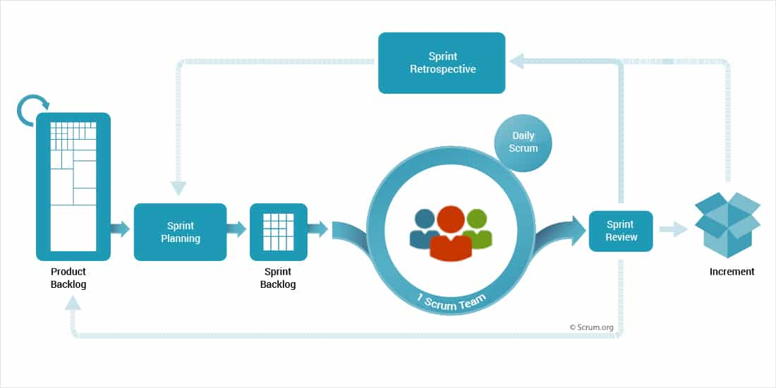
SCRUM
Image Source: https://www.nutcache.com

Slide 5
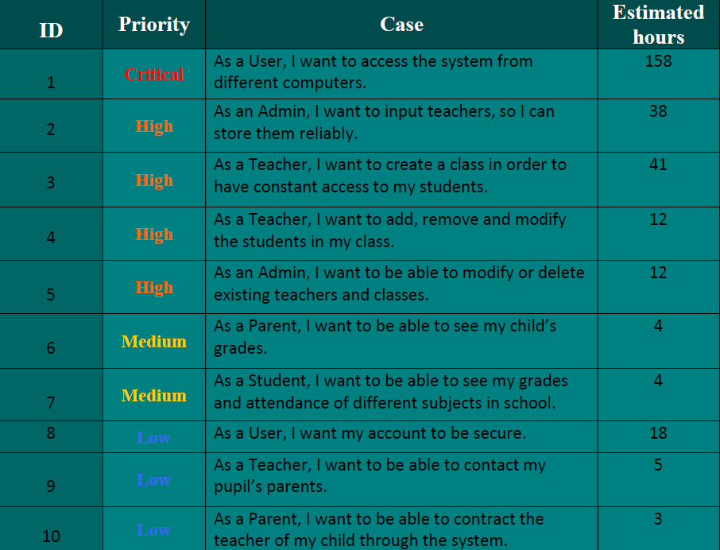
Product Backlog

Slide 6

Daily Scrum Meetings

Slide 7
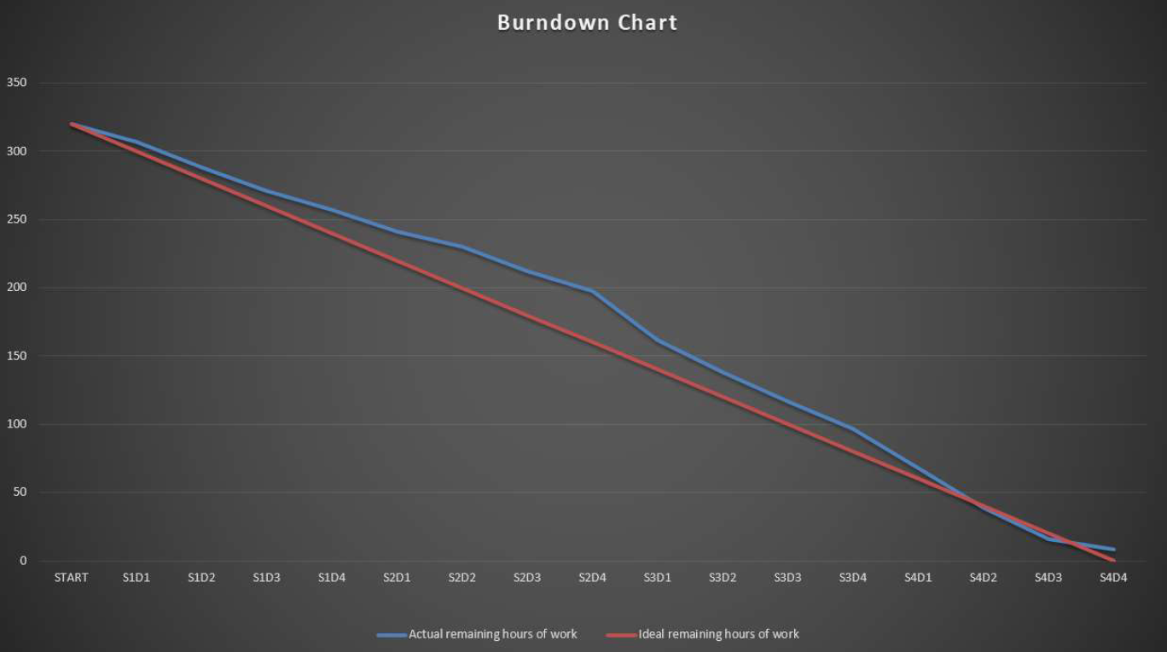
Burndown Chart

Slide 8
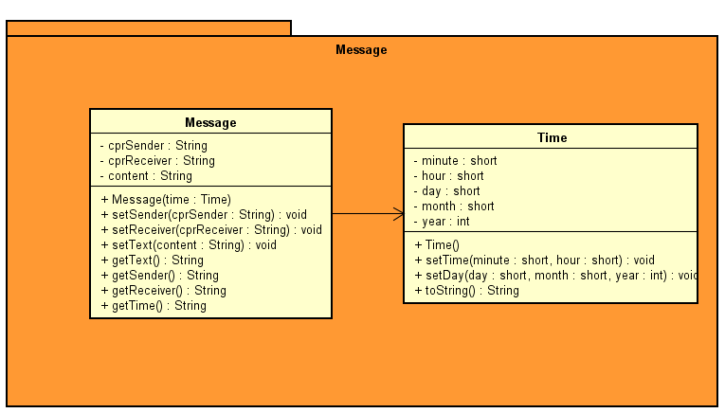
Function cuts

Slide 9
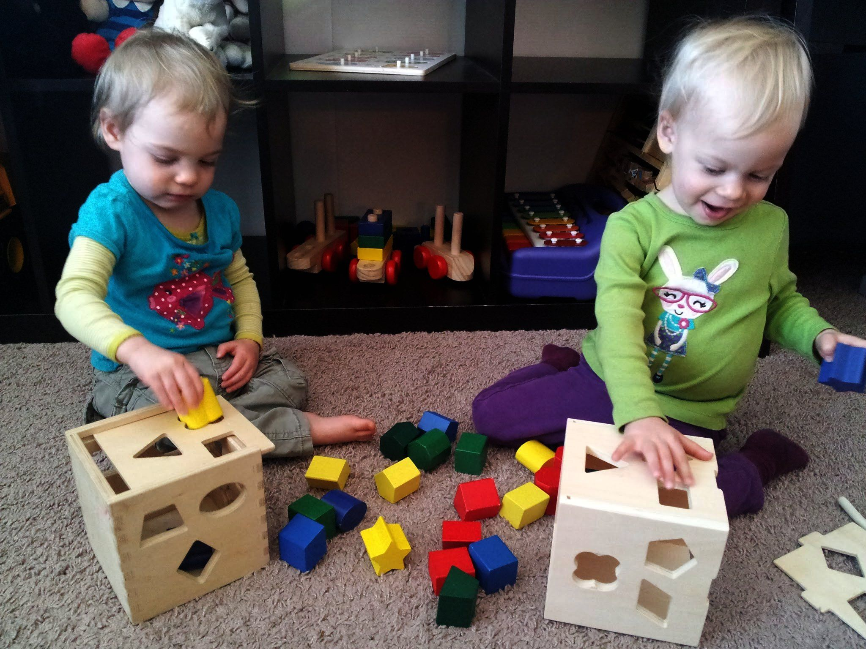
Testing

Slide 10
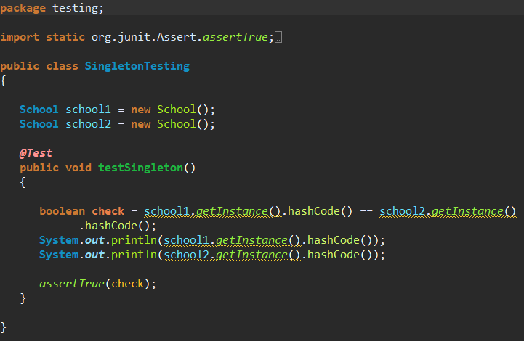
Junit testing

Slide 11
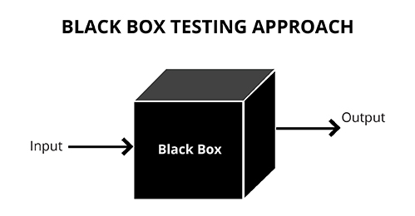
Black Box Testing
Image source: https://www.invensis.net

Slide 12
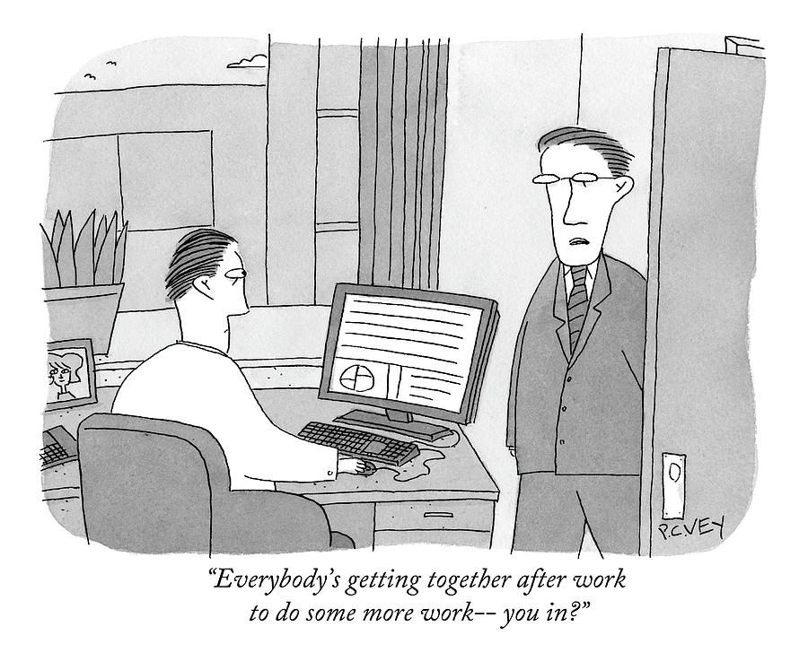
Do more testing

Slide 13
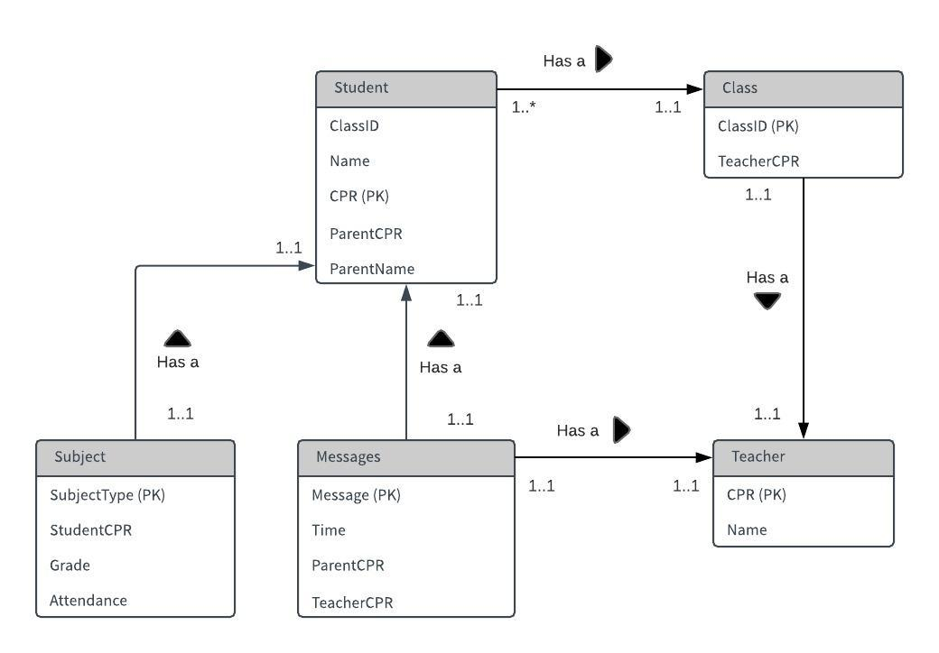
Our Database

Slide 14

Procedure

Slide 15
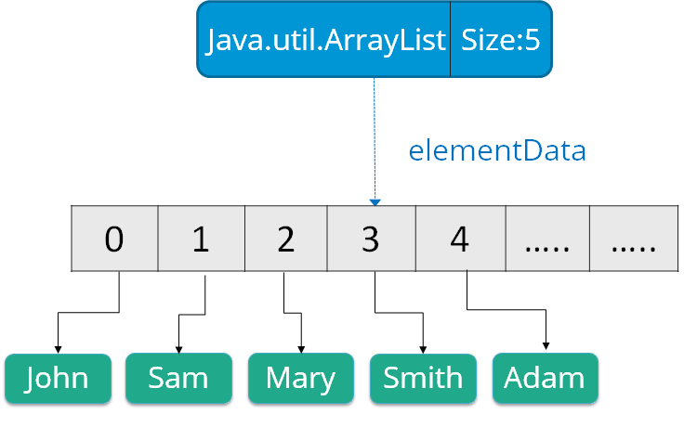
Data in the system

Slide 16
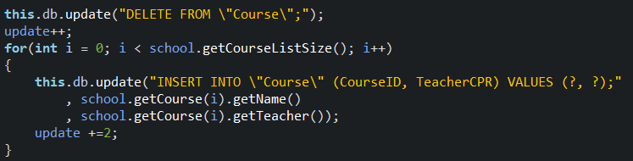
Database/System Connection

Slide 17

Errors
Data consistency
Save data

Slide 18
What have we done ?

Slide 19


Slide 20
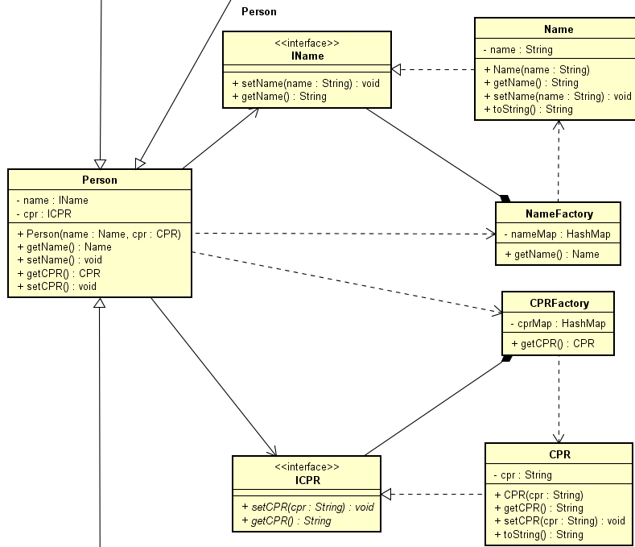
The little bugger Flyweight

Slide 21
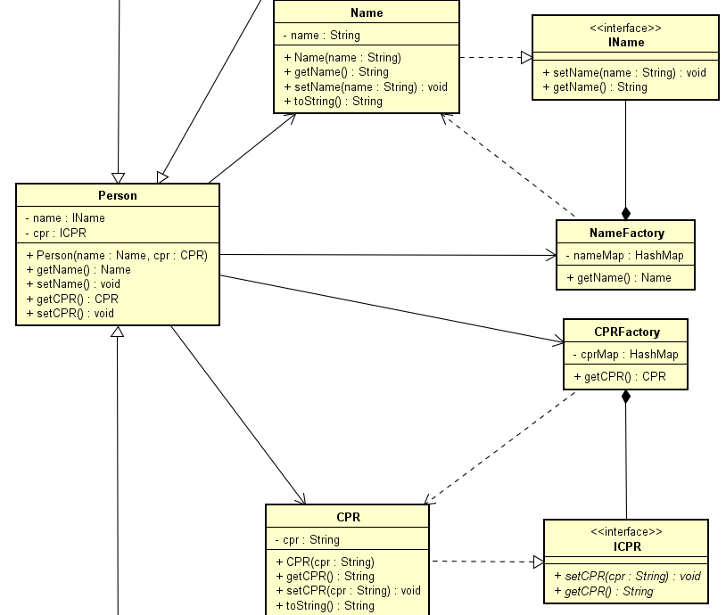
Flyweight 2.0

Slide 22
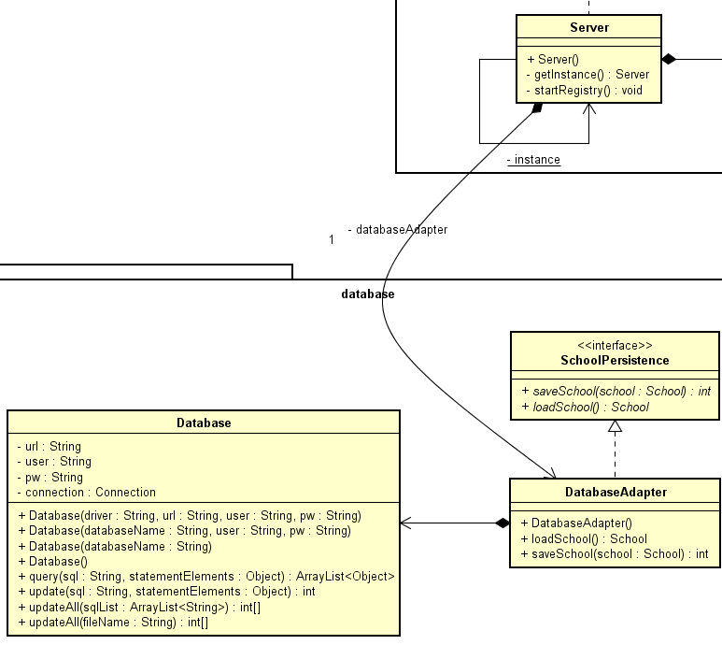
His partner in crime Adapter

Slide 23
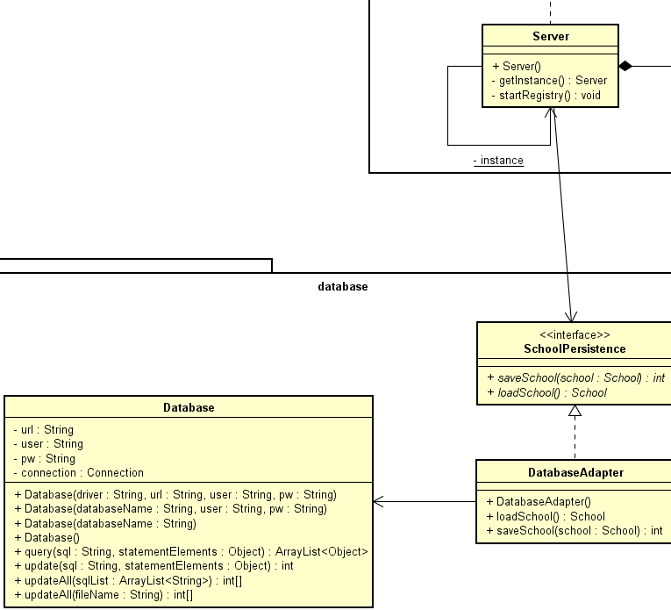
Adapter 2.0

Slide 24

Looking at the bright side

Slide 25

Patterns are not fully utilized
Proxy
Flyweight

Slide 26

Happy with what we have

Slide 27


The unsung heroes
- Observer
- State

Slide 28
The fallen comrades

Slide 29

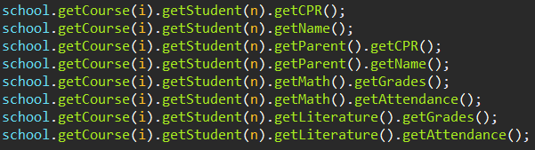
Loose coupling

Slide 30

Lack of comments

Slide 31

The structure of the system and its future

